Slide 1


Slide 2





Our team:
Naresh Gubba
Bhanu
Ved Kumar
Mohit
Jeevan

Slide 3




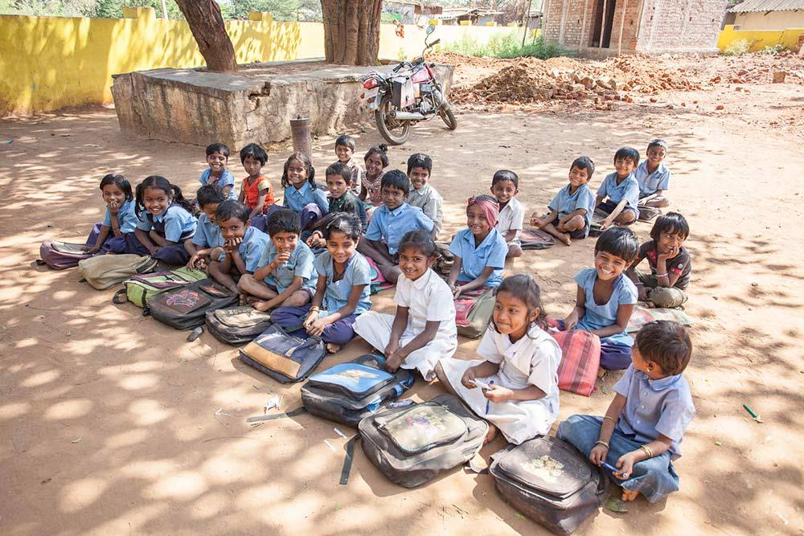
Bunty
Chintu

Slide 4
Execution Summary:
Domain - Education
Gather Data
Target
Factors Affecting
Analyze
Model Creation
Solution
Prediction

Slide 5
Role of Analytics:
Social – Emotional Skills
Social-Emotional Skill is an important area that needs to be developed through education. Through this, a child learns to acquire a capacity to understand, analyze, express and manage emotions..
Monitoring Student Requirements
There are several evaluation and assessment techniques that are utilized by educational institutes. However, such traditional methodologies were often unable to capture and encapsulate all the important trends and patterns of student services.
Innovating the Curriculum
Various Universities have to keep themselves updated with the demands of the industry so as to provide appropriate courses to their students. Furthermore, it is a challenge for the universities to keep up with the growth of industries.
Measuring Instructor Performance
The performance of students depends on the teachers. While there are many assessment techniques that have been used to assess the performance of teachers, it has been mostly manual in nature.

Slide 6
Factors influence:
Social
Population Explosion
Political
Stagnation
Economic & Financial
Physical

Slide 7
World Literacy Rate:
99%
7.3
Billion
98%
97%
72%
88%

Slide 8
Data Analysis:
18%
60%
Total Population (0-14) - 18%
Enrolled in Schools - 60%
Teachers - 55%
Infrastructure - 40%
55%
40%

Slide 9
Literacy rate Variation:
1981
1991
2001
2006
2011
40.76% Over all
48.22% Over all
61.01% Over all
62.75% Over all
69.03% Over all
54.84% Male
61.64% Male
73.41% Male
75.19% Male
78.88% Male
25.68% Female
33.73% Female
47.84% Female
50.82% Female
59.28% Female

Slide 10
Literacy Rate- 2015:
72%
Over all
81%
63%
Male
Female

Slide 11
Literacy Rate State Wise:

Slide 12
Literacy Rate Gender Wise:

Slide 13
Literacy Rate Comparison:

Slide 14
Total Schools:

Slide 15
Dataset Description:
District wise Indian primary and secondary school education data for 2015-16.
From Ministry of Human Resource Development
680 observations and 819 variables
Variables include
Basic data from 2011 census (Total Population, Growth Rate, Sex ratio, Literacy Rate)
Count of Schools by various categories like
Primary / Upper Primary / Secondary
Government / Private / Madrasas and Unrecognized
Rural
Count of students enrolled for each
school category, caste, grade, special needs, nature of disabilities
Count of Teachers for each
School category, Gender, Caste, age group, Educational Qualifications, Regular/Contractual
Number of classrooms by school category, conditions
TLM grants, Development Grants received, expended
Incentives –textbooks, Uniforms

Slide 16
Feature Selection:
Manually selected the important variables / variables we want to study
Factors we considered:
Type of School - Government/Private; Rural; Boys Only/Girls Only
School Facilities - Playground, Toilets, Drinking water, Electricity, Computer, Meals
Enrolment count
Number of Teachers, Professionally qualified teachers
Number of classrooms
Condition of Classrooms
PTR - Pupil teacher Ratio; SCR - student classroom ratio
Grants
Incentives - Textbook, Uniform

Slide 17
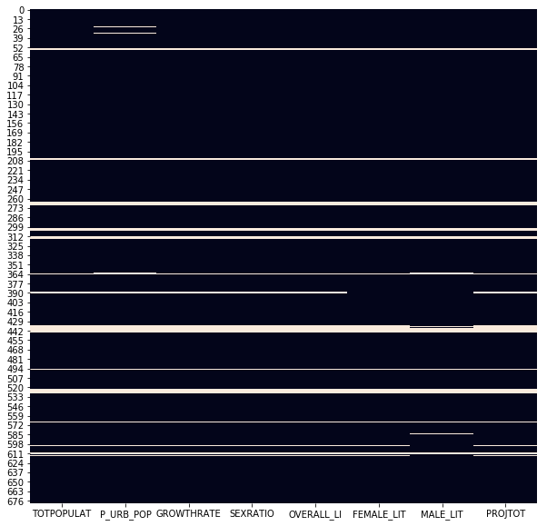
Handling Missing Values:
Values missing in same 8 columns for 49 rows
In 3 cases, we can impute missing values for Literacy Rate using Male literacy rate, female literacy rate and sex ratio
In other cases, all target variables are missing

Slide 18
Regression Techniques | Train Score | Test Score | Performance
OLS | 0.687 | 0.793 | Good
KNN | 0.812 | 0.577 | Overfit
KNN WITH GRID SEARCH | 0.615 | 0.596 | Overfit
Decision Tree (MAE) | 0.745 | 0.627 | Overfit
Decision Tree( MSE) | 0.597 | 0.569 | Overfit
Random Forest | 0.754 | 0.669 | Overfit
AdaBoost Regressor | 0.769 | 0.664 | Overfit
Gradient Boosting Regressor | 0.585 | 0.539 | Overfit

Slide 19
Comparing Train & Test Scores:

Slide 20
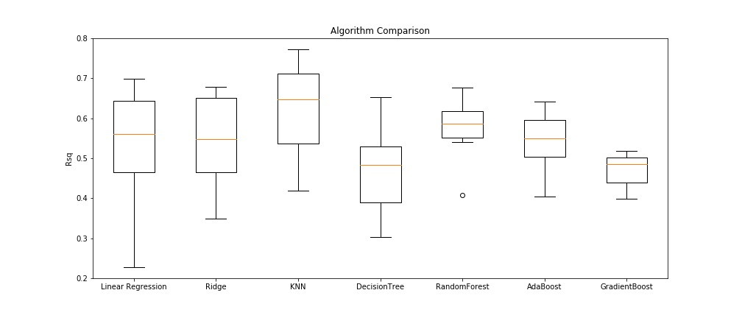

Slide 21
Factors Affecting Literacy Rate:
Enrollment in Govt School
Schools with PTR>35
Schools with PTR >30 (-)
Urban Population
Enrollment in Private School
Schools with Play Ground
Sex Ratio (-)
Teachers in Govt School (-)
Schools with Computer
Projected Students (-)
Teachers in Private School (-)
Enrollment in Girls Schools

Slide 22
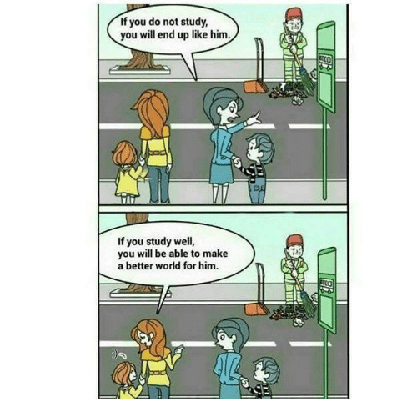
Is there anything to ask?

